Slide 1


Your Voice. Your UF. Your Ideas
Notes:
Time: 0
Pre-workshop

Slide 2
For Today
Summarize the process
Review key results related to faculty
Discuss next steps
Answer your questions

Slide 3
Faculty and Staff
Climate Survey
Completed in fall 2015
Results became available in June
  Town hall meetings with Dr. Sue Rankin (Rankin and Associates) in June and then again in September
  Report, complete PPT available online
College-level information available beginning Jan. 2
Forums to discuss the results since June
  Also can weigh in online
http://president.ufl.edu/initiatives/uf-faculty-and-staff-climate-survey/

Slide 4
Assessing Campus Climate
What is it?
Campus Climate is a construct
Definition?
Current attitudes, behaviors, and standards and practices of employees and students of an institution
How is it measured?
Personal Experiences
Perceptions
Institutional Efforts
Rankin & Reason, 2008

Slide 5
Project Overview
Phase I
Phase II
Assessment Tool Development and Implementation
Data Analysis
Phase III
  Final Report and Presentation

Slide 6
Survey Limitations
Self-selection bias
Response rates
Social desirability
Caution in generalizing results for constituent groups with low response rates

Slide 7
Method Limitation
Data were not reported for groups of fewer than 5 individuals where identity could be compromised
Instead, small groups were combined to eliminate possibility of identifying individuals

Slide 8

Results
Response Rates

Slide 9
Who are the respondents?
5,590 people responded to the call to participate
36.1% overall response rate

Slide 10
Response Rates by Position
36%
Faculty (n = 2,037)
37%
Staff (n = 3,277)
19%
Postdoctoral Associate (n = 117)
40%
University Athletic Association (n = 159)

Slide 11
Respondents’ Racial/Ethnic Identity (%) (Unduplicated Total)

Slide 12
Respondents by Gender Identity and Position Status (%)
Note: Responses with n < 5 are not presented in the figure.

Slide 13
Respondents by Sexual Identity and Position Status (n)
Note: Responses with n < 5 are not presented in the figure.

Slide 14
9% (n = 511) of Respondents Had Disabilities that Substantially Affected Learning, Working, or Living Activities
Condition | n | %
Chronic diagnosis or medical condition | 154 | 30.1
Mental health/psychological condition | 107 | 20.9
Learning disability | 95 | 18.6
Physical/mobility condition that affects walking | 94 | 18.4
Hearing impaired or deaf | 37 | 7.2
A disability/condition not listed here | 38 | 7.4
Physical/mobility condition that does not affect walking | 30 | 5.9
Visually impaired or blind | 27 | 5.3
Speech/communication condition | 12 | 2.3
Acquired/traumatic brain injury | 12 | 2.3
Asperger’s/Autism spectrum | 6 | 1.2

Slide 15
Respondents by
Faith-Based Affiliation (%)

Slide 16
Citizenship Status
Citizenship
 | n | %
U.S. citizen, birth | 4,754 | 84.4
U.S. citizen, naturalized | 478 | 8.4
Permanent Resident | 284 | 5.0
A visa holder (such as J-1, H1-B, and U) | 100 | 1.8
Other legally documented status | 13 | 0.2
Refugee status | < 5 | ---
Currently under a withholding of removal status | 0 | 0.0
DACA (Deferred Action for Childhood Arrival) | 0 | 0.0
DAPA (Deferred Action for Parental Accountability) | 0 | 0.0

Slide 17


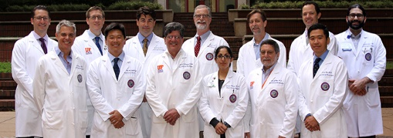
Findings

Slide 18
Comfort Levels with Climate
Overall Campus (73%)
Department or Work Unit (70%)
Classroom or learning environment (faculty) (85%)

Slide 19


Challenges and Opportunities

Slide 20
Personal Experiences of Exclusionary, Intimidating, Offensive or Hostile Conduct
24%
1,325 respondents indicated that they had personally experienced exclusionary (e.g., shunned, ignored), intimidating, offensive and/or hostile conduct at University of Florida in the past year

Slide 21

Personally Experienced Based on…(%)
Note: Only answered by respondents who experienced exclusionary conduct (n = 1,325).
Percentages do not sum to 100 due to multiple responses.

Slide 22
Top 6 Forms of Experienced Exclusionary, Intimidating, Offensive or Hostile Conduct
 | n | %
Experienced a hostile work environment. | 634 | 47.8
Ignored or excluded. | 616 | 46.5
Intimidated/bullied. | 597 | 45.1
Isolated or left out. | 500 | 37.7
Target of workplace incivility. | 391 | 29.5
Target of derogatory verbal remarks. | 379 | 28.6
Note: Only answered by respondents who experienced exclusionary conduct (n = 1,325).
Percentages do not sum to 100 due to multiple responses.

Slide 23
Qualitative Theme
Experienced Exclusionary Conduct
Supervisor/Administrator incivility
Coworker incivility
Negative environment
Concerns with reporting incivility

Slide 24
Respondents Who Seriously Considered Leaving University of Florida
63% of Faculty respondents (n = 1,287)
54% of Staff respondents (n = 1,746)
56% of Postdoctoral Associate respondents (n = 76)

Slide 25
Top 7 Reasons Respondents Seriously Considered Leaving University of Florida
 | n | %
Financial reasons (salary, resources, etc.) | 1,684 | 53.1
Limited opportunities for advancement | 1,377 | 43.4
Tension with supervisor/manager | 1,007 | 31.8
Interested in a position at another institution/employer | 979 | 30.9
Climate was not welcoming | 977 | 30.8
Increased workload | 965 | 30.4
Recruited or offered a position at another institution/employer | 692 | 21.8
Note: Table includes answers from only those respondents who indicated that they considered leaving (n = 3,171).

Slide 26
Qualitative Themes for Respondents
Why Considered leaving…
Lack of compensation (benefits, salary, workload)
Negative work environment
Lack of professional development
Top-down leadership – Lack of voice

Slide 27

Perceptions

Slide 28
Respondents who observed conduct or communications directed towards a person/group of people that created an exclusionary, intimidating, offensive and/or hostile working or learning environment…
27% (n = 1,488)

Slide 29
Top 7 Forms of Observed Exclusionary, Intimidating, Offensive, or Hostile Conduct
 | n | %
Derogatory remarks | 746 | 50.1
Person experienced a hostile work environment | 618 | 41.5
Person intimidated/bullied | 562 | 37.8
Person isolated or left out | 494 | 33.2
Person deliberately ignored or excluded | 402 | 27.0
Person was the target of workplace incivility | 378 | 25.4
Person received a low performance evaluation | 218 | 14.7
Note: Only answered by respondents who observed harassment (n = 1,488).
Percentages do not sum to 100 due to multiple responses.

Slide 30
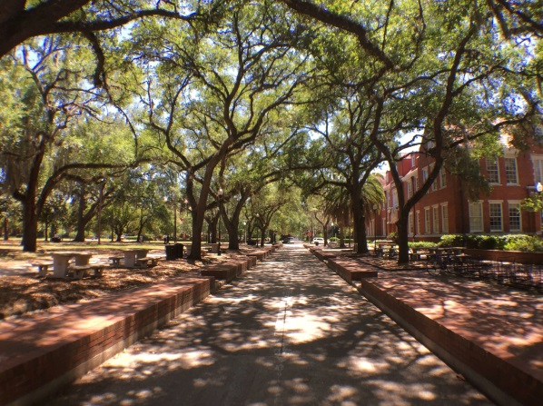
Employee Perceptions

Slide 31
Employee Perceptions of Unfair/Unjust
Hiring Practices
23% Faculty respondents
13% Postdoctoral Associate respondents
24% Staff respondents

Slide 32
Employee Perceptions of Unfair/Unjust Employment-Related Disciplinary Actions
14% Faculty respondents
6% Postdoctoral Associate respondents
14% Staff respondents

Slide 33
Employee Perceptions of Unfair/Unjust
Practices Related to Promotion
31% Faculty respondents
13% Postdoctoral Associate respondents
26% Staff respondents

Slide 34
Most Common Bases for Discriminatory Employment Practices
Friendship
Gender/Gender Identity
Ethnicity
Age
Racial Identity
Nepotism
Position

Slide 35
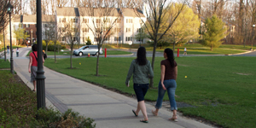
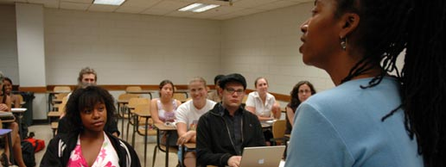
Work-Life Issues
SUCCESSES & CHALLENGES
Positive views of campus climate were held by the majority of respondents.

Slide 36
Tenured and Tenure-Accruing Faculty Respondents
Examples of Successes
88% felt that research was valued by UF
75% felt criteria for tenure were clear
74% felt that they had opportunities to participate in substantive committee assignments

Slide 37
Tenured and Tenure-Accruing Faculty Respondents
Examples of Challenges
58%
50%
Disagreed that faculty opinions are taken seriously by senior administrators
Performed more work to help students than did their colleagues
42%
Burdened by service responsibilities beyond those of their colleagues with similar performance expectations

Slide 38
Qualitative Themes
Tenured and Tenure-Accruing Faculty Respondents
Work-Life Attitudes
Lack of respect
Difficulty balancing research, service, and teaching
Unclear tenure and promotion process

Slide 39
Non-Tenure-Accruing, Permanent Status, Permanent Status Accruing, and Adjunct Faculty Respondents
Examples of Successes
92% agreed that research was valued by UF
73% agreed that teaching was valued by UF
76% believed that clear expectations existed of their responsibilities

Slide 40
Non-Tenure-Accruing, Permanent Status, Permanent Status Accruing, and Adjunct Faculty Respondents
Examples of Challenges
48%
40%
Felt pressured to do extra work that was uncompensated
Believed that they performed more work to help students than did their colleagues
38%
Felt burdened by service responsibilities beyond those of their colleagues with similar performance expectations

Slide 41
Qualitative Themes
Non-Tenure-Accruing, Permanent Status, Permanent Status Accruing, and Adjunct Faculty Respondents
Work-Life Attitudes
Lack of compensation for workload expectations
Unclear criteria for advancement
Value of research over teaching

Slide 42
Qualitative Themes
Non-Tenure-Accruing, Permanent Status, Permanent Status Accruing, and Adjunct Faculty Respondents
Work-Life Attitudes
Faculty voices ignored
De-valuing “Extension”

Slide 43
All Faculty Respondents
Examples of Successes
76% believed they had job security
74% believed their colleagues included them in opportunities that will help their career as much as they do others in their position
75% reported that health insurance benefits were competitive

Slide 44
All Faculty Respondents
Examples of Challenges
65%
56%
Believed that people who have children or elder care were burdened with balancing work and family responsibilities
Disagreed that salaries for adjunct professors are competitive
21%
Believed that people who do not have children were burdened with work responsibilities beyond those who do have children

Slide 45
Qualitative Themes
All Faculty Respondents
Work-Life Attitudes
Lack of competitive salaries/Decreasing benefits
Lack of faculty support
Work-life issues
Lack of job security

Slide 46
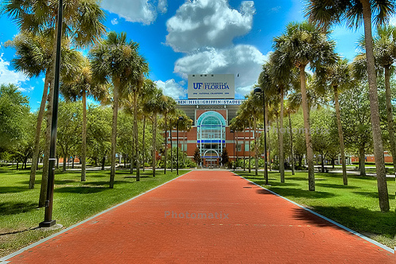
Institutional Actions

Slide 47
Faculty and Postdoctoral Associate Respondents’ Perceptions of Campus Initiatives that Positively Influenced Climate
Mentorship for new faculty
Fair process to resolve conflicts
Access to adequate childcare
Clear process to resolve conflicts

Slide 48
Faculty and Postdoctoral Associate Respondents’ Perceptions of Campus Initiatives that Positively Influenced Climate
Career span development opportunities for faculty at all ranks
Resources for reporting concerns
Flexibility for stopping the tenure clock
Access to counseling for people who have experienced harassment

Slide 49
Faculty and Postdoctoral Associate Respondents’ Perceptions of Campus Initiatives that Influenced Climate Less Positively
Diversity-related professional experiences as one of the criteria for hiring of staff/faculty
Equity and diversity training to promotion and tenure committees
Diversity and equity training for faculty
Equity and diversity training to search committees
Recognition and rewards for including diversity issues in courses across the curriculum

Slide 50

Summary
Strengths and Successes
Opportunities for Improvement

Slide 51
Overall Strengths and Successes
62% of respondents were comfortable with the climate in their classes/learning environment
The majority of respondents expressed positive perceptions of the workplace climate
70-73% of respondents were comfortable with the overall climate and department/work unit climate at UF
The majority of respondents felt valued and that their work was valued at UF.

Slide 52
Overall Challenges and Opportunities for Improvement
27% had observed exclusionary conduct within the last year at UF
33% of respondents felt valued by senior administration
24% had personally experienced exclusionary conduct within the last year at UF
57% of respondents seriously considered leaving UF

Slide 53
Next Steps
Faculty and staff forums will be held for various campus organizations or areas of campus that have asked for a session
Also can participate online:
http://president.ufl.edu/initiatives/uf-faculty-and-staff-climate-survey/

Slide 54
Next Steps
Ideas generated at forums will be reviewed for themes and will be narrowed into possible action items to move forward
Emphasis will be on action that can be taken over the next 12 to 18 months
In addition to the survey report now available online, college-level information will be available beginning Jan. 2

